Slide 1
Pub/Sub Middleware for WSN

Slide 2
Motivation
Most of the existing WSN applications are event-based:
  Event Subscription: user define and subscribe the events
  Event Monitoring: sensor nodes observe the environment and exchange information.
  Event Detection: sensor nodes make a decision on the occurrence of an event.
  Event Delivery: sensor nodes report the detected to user
No existing work considers composite event subscription / delivery in WSN

Slide 3


Contributions
Event Definition Language (EDL): can be used conveniently to write WSN applications
A simple yet easy-to-implement event detection protocol.
Implement the whole system
  EDL Compiler
  VM-based runtime environment

Slide 4
Related Works – WSN Programming Abstraction
SQL: TinyDB
Object-tracking: EnviroTrack
Agent: Agilla
VM: Mate
Neighbor-based: Hood
Service: SNACK
Functional: Regiment
Declarative: DSN

Slide 5
Related Works – Pub/sub for WSN
Low-level naming & Diffusion filters: based on directed diffusion with attribute-based naming.
Mires: makes use of message-oriented feature provided by TinyOS.
Semi-probabilistic: improve the dissemination performance by letting flooding stop after certain number of hops.

Slide 6
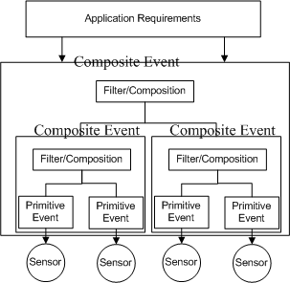
EDL
Programming model:
  Primitive events – directly obtainable from sensors
  Composite event – obtained by event composition and filtering

Slide 7
Language Elements
Event Definition
  Attributes
  Event methods
    ‘occurred()’: define the occurrence of an event (filter)
    ‘composite()’: define how events are composed
Event Inheritance
  User-defined events are inherited from ‘System’ event
  System event is a primitive event. All its attributes can be directly obtained from sensors.
Subscription statement

Slide 8
Defining Events
Defining Primitive Events
  By using only attributes that are directly available from the ‘System’ event.
  By defining simple filtering method which has predicates on the attributes.
Defining Composite Events
  Defining attributes that are going to be obtained.
  Defining methods to specify how to obtain these attributes.
    Composite(): the method which will be executed on all sensor nodes in the network. Inside the method, programmers can define logics about how to use the primitive events to obtain the desired data.

Slide 9
Primitive Event
LightEvent {
  int light;
  bool occurred () {
    if (light>threshold)
      return true;
  }
}

Slide 10
Case One - Monitoring
Two rooms: A and B and the user wants to subscribe to a composite event such that the average temperature of room A rises above 30 and then after 10 minutes, the average temperature of room B also rises above 30.

Slide 11
Case One - Monitoring
  Event AB {
  bool detected=false;
  bool occurred () {
  composite();
  return detected;
  }
  TempAverageEvent a, b;
  void composite () {
  if (a==null)
  a=new TempAverageEvent ('A');
  if (b==null)
  b=new TempAverageEvent ('B');
  if (a.occurred() && b.occurred()
  && b.time-a.time>=10*60*1000)
  detected=true;
  }
  }

Slide 12
Case Two - Tracking
  Event Track {
  bool detected=false;
  bool occurred () {
  composite();
  return detected;
  }
  DetectEvent history[10];
  void composite () {
  DetectEvent e=new DetectEvent();
  if (e.occurred())
  addToHistory (e);
  if (patternDetected(history))
  detected=true;
  }
  }

Slide 13
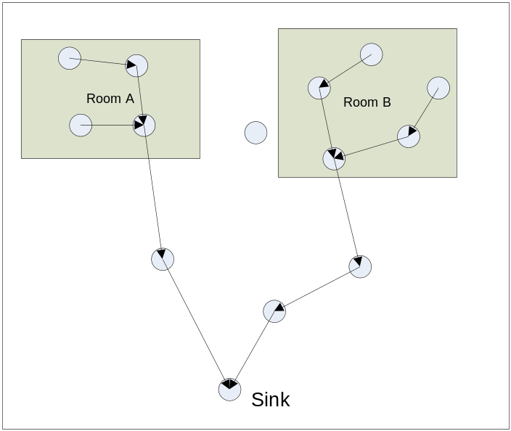
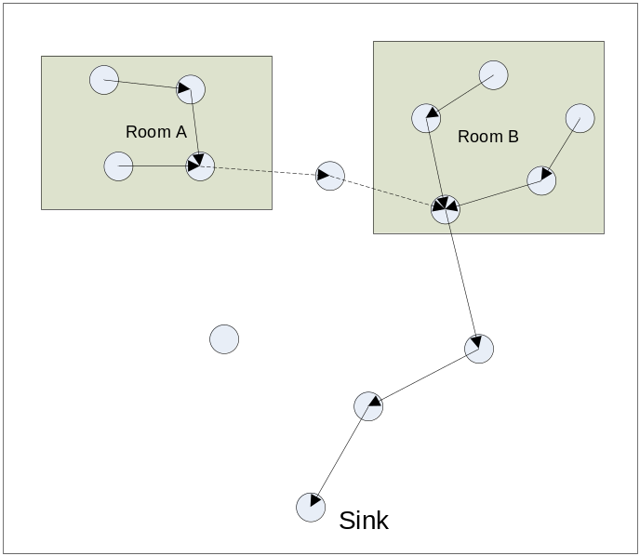
Event Detection Protocol
Scenario for efficient event detection:

Slide 14
Event Detection Protocol
Objective:
  By making use of the event temporal relationships, detect the composite events in an energy-efficient way.
Steps:
  Event analysis: Get the temporal relationships among events.
  Parent selection: each sensor node selects a group of nodes to exchange data during event monitoring.
  Parent filtering: only a small number of parents selected in the previous step will be finally selected in order to save energy. Some nodes will be elected to be the event detector and will need to make a decision on the occurrence of an event.
  Event detection: define policies on when the sensor nodes should start monitoring so that sampling cost and communication costs can be further reduced.

Slide 15
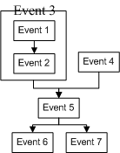
Step 1 - Event Analysis
Why?
  Events have strong temporal relationships
  Events may be filtered by static attributes (ID, location)
Output:
  Event ID: E={e₁, e₂, …e_{n}}
  Event Filters (decide whether a sensor will be involved in detecting an event): F={f₁, f₂, …f_{n}}
  Event Relationship: R={e_{m}-> e_{n}| e_{m}, e_{n} ∈ E}

Slide 16
Step 2 - Parent Selection
Input:
  Event ID: E={e₁, e₂, …e_{n}}
  Event Filters: F={f₁, f₂, …f_{n}}
  Event Relationship: R={e_{m}-> e_{n}| e_{m}, e_{n} ∈ E}
  Filtering Results (bitmap): B = {b₁, b₂, … b_{n}} where each b_{i} ∈ B is either 0 (not sure whether or not needs to detect an event) or 1 (will be involved in detecting an event)
  Neighbor’s Filtering Results (bitmap): B’ = {b₁’, b₂’, … b_{n}’} where each b_{i}’ ∈ B is either 0 or 1
  Filtering Progress (bitmap): B”= {b₁”, b₂”, … b_{n}”} where each b_{i}” ∈ B is either 0 or 1

Slide 17

Basic Ideas 1
Bitmaps are used to keep track of the event detection progress
  Originally: B”=B
  Receive B” from neighbor
    If same as its own B”: no progress – discard the message
    If different: new progress – add the neighbor to the candidate parent list (based on B’).
    If different: combine B” with my own B” and broadcast the new B” to the neighbors.

Slide 18



Basic Idea 2
Three heuristics:
  Two nodes can detect the same event: then they need to work together and select the parents so that data will be forwarded towards the event which will be triggered
  One event triggers another: some sensor nodes responsible for the first event needs to have some parents that can reach the second on.
  Some sensor nodes need to relay the messages in order to help to detect a non-contiguous event

Slide 19
Basic Idea 3
Event forwarding table (for each node):
  ForwardTable {
  ParentList;
  ChildList;
  } forward [n];
Meaning of each entry: when the node is monitoring the event n, the monitored data will be forwarded to the nodes in forward[n].ParentList and the node should wait for the monitored data from the nodes in ChildList.

Slide 20
Basic Idea 4
Define a root event which can only be detected by the sink.
The root event will be triggered by the event subscribed by the user.
Why?
  Naturally allow the subscribed event to be finally routed to the sink.
  In the forwarding table, the entry for the root event also serves as a default routing entry. If a node is detecting an event that cannot be filtered with static filters, it will use that entry to forward the data. This will allow the sink to gather all the data and do the event detection.

Slide 21
Step 3 – Parent Filtering
Why?
  Further select a small number of parents as the real forwarding nodes
Requirements (heuristics)
  Within one event, choose only one parent
  If one event can trigger multiple events, multiple parents may be necessary
  Event detector is necessary to make a unanimous decision before triggering other events

Slide 22
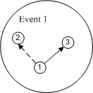
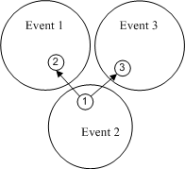
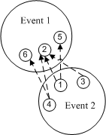
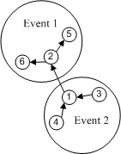
Requirements (cont.)

Slide 23
Solution (Heuristics)
Cost Estimation
  For each forwarded B’, the cost will be incremented by one
For each of the event which can be detected by the current node (b_{i}==1 ):
  If there are any parents which are detecting the same event. If there are choose them first (with the min cost) because an event needs to be detected first in order to trigger others.
  For each of the event that can be detected by the current node but not by the parent node, then all parent nodes must either be the forwarding node or the nodes to be triggered. After the one with min cost is selected, a simple leader election protocol is needed.
  ID is used to break the tie.
For each of the event which cannot be detected by the current node (b_{i}==0 ):
  Just select the one with minimun cost

Slide 24
Step 4 – Event Detection
Heuristics:
  Start monitoring and detecting events only if all the triggering events have occurred or there is no triggering event.
  Wake-up message sent by the event detector need to be flooded.

Slide 25
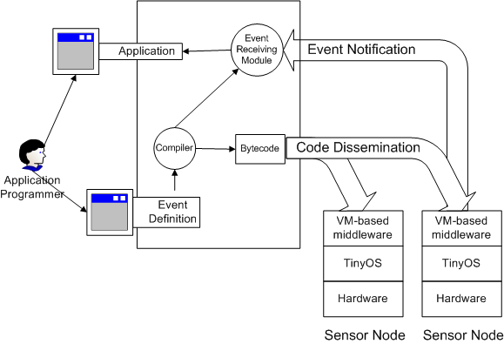
System Design
Architecture:

Slide 26
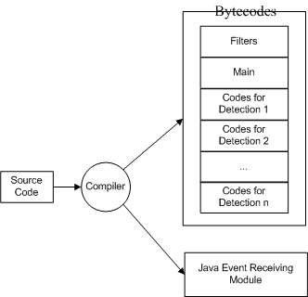
The Compiler

Slide 27
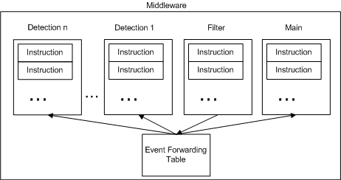
The VM Runtime Environment

